Slide 1
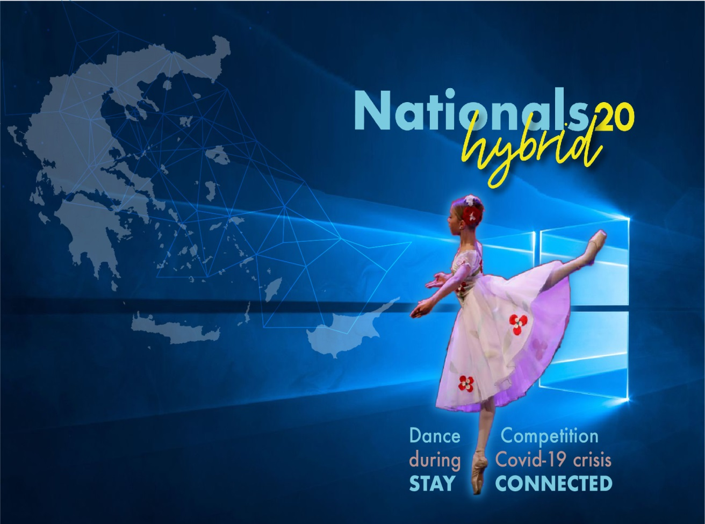
Hard decision making: Cancel Or Postpone a participatory ballet event during covid-19 crisis?
The decision-making framework included the following steps:
Identifying the reasons
Facing the option of canceling the competition
Identifying the alternatives
Ethical decision-making
Choosing among the alternatives
Rescheduling and Redefining the strategic planning of the competition
Establishing a highly effective communication policy

Slide 2


Stakeholders’ co-creation of value in the event
a) Experts
b) Judges
c) Participants
d) Sponsors

Slide 3

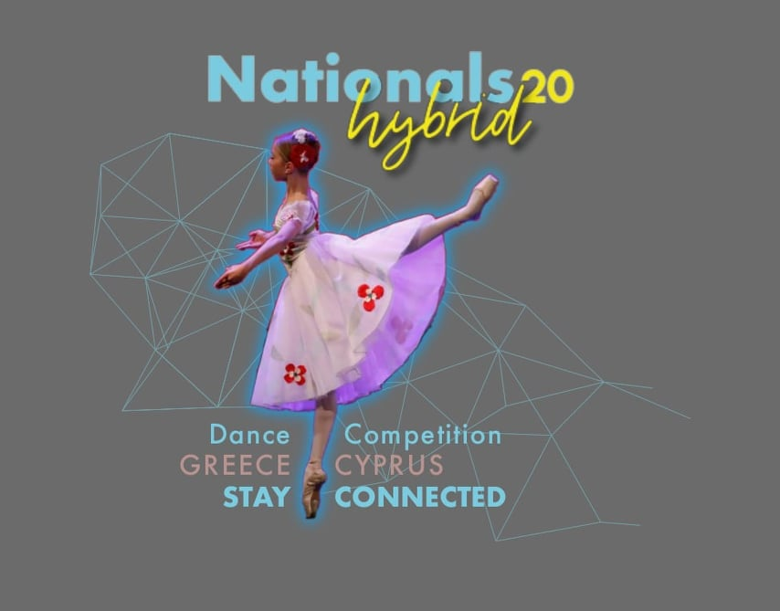
Key lessons :
Reacting to a crisis requires multi-dimensional thinking and methodical problem-solving for adaptation
Choosing the right tools and experts is crucial
Scaling up the event is possible when the strategic plan is redefined and an effective communication policy is applied
Maximizing stakeholder engagement through investing in collaborative co-creation processes

